Slide 1
Back 2 School Quiz
Celebrating 10 Years of the
Smart Start Project

Slide 2
Every 1 in 3 Primary School Children lives in Poverty.
Department for Working Pensions, 21 March 2024
Poverty means not being able to heat your home, pay your rent or buy the essentials for your children.
Joseph Rowntree Foundation

Slide 3

4.5 million
89,000
children live in poverty in
the UK
children live in poverty in Manchester & Salford
43%
48%

Slide 4
Overview
We have been supporting local children with access to school equipment since the beginning of the charity, providing clogs to those in need.
In 2015 we launched the Smart Start Project, providing free school uniform to those local children in need.
This year we celebrate 10 years of the project, and we are looking to smash a target to raise £10,000 through our Back to School Quiz.
We look forward to welcoming you to the best quiz in town and celebrate 10 years with fantastic local businesses and proud supporters. Thank-you!

Slide 5
Quiz Team
£475.00 to enter, includes:
Team up to 8 people
Complimentary arrival drink
Chicken dinner
Live Quizmaster
Bring your team and enjoy a great evening of fun, competitiveness and raising vital funds for the Smart Start Project!
10th September, 6-9.30pm, Manchester Hall, M3 3BT

Slide 6
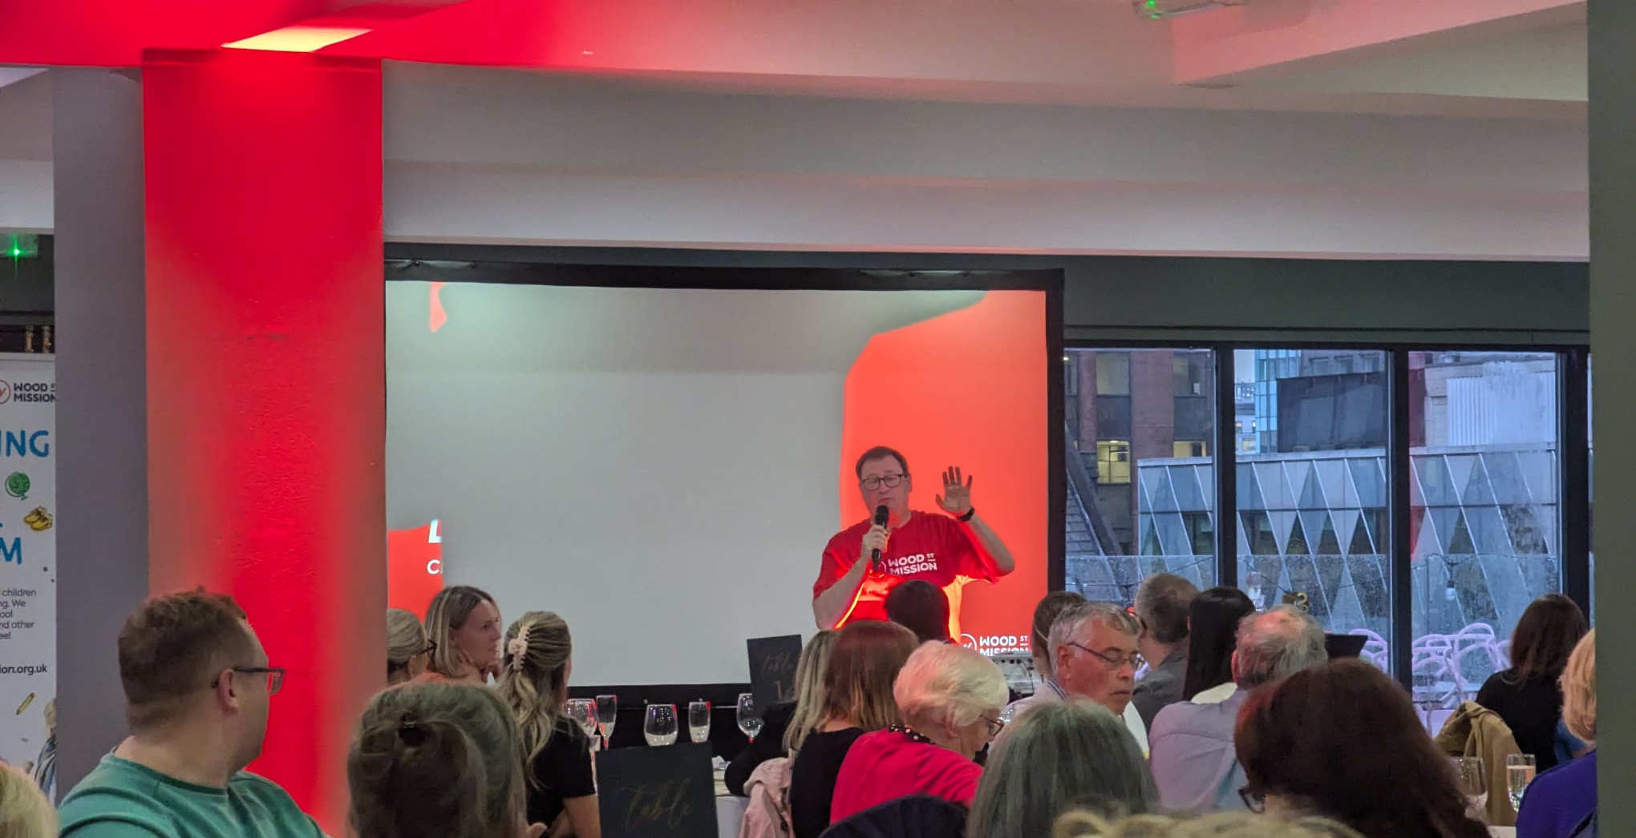


Event Sponsor
£5,000
Venue
Catering
AV
Quizmaster
Recognised on all marketing as event sponsors
Recognised on the night as proud supporters of the Smart Start Project
Recognised on our website as proud supporters of Wood Street Mission for 12 months.
Impact information available for CSR

Slide 7

School Uniform
Each year we support families with free new school uniform delivered directly to their door, easing the financial and emotional stress of the new school year for parents.
Be a ‘Back to School: Uniform Hero’ and donate from:
£1,000
Recognised on the night as proud supporters of the Smart Start Project
Recognised on our website as proud supporters of Wood Street Mission
Impact information for CSR reporting

Slide 8

School Coats
Each year we support families with new winter coats. Many children must walk to school or wait for the bus in the cold winter months with no coat. With your support we will help keep children warm and ready for school.
Be a ‘Back to School: Uniform Hero’ and donate from:
£1,000
Recognised on the night as proud supporters of the Smart Start Project
Recognised on our website as proud supporters of Wood Street Mission
Impact information for CSR reporting
No child should arrive at school cold and wet
Notes:
Do you think we could find a stock (free!) image of a child in a winter coat?

Slide 9
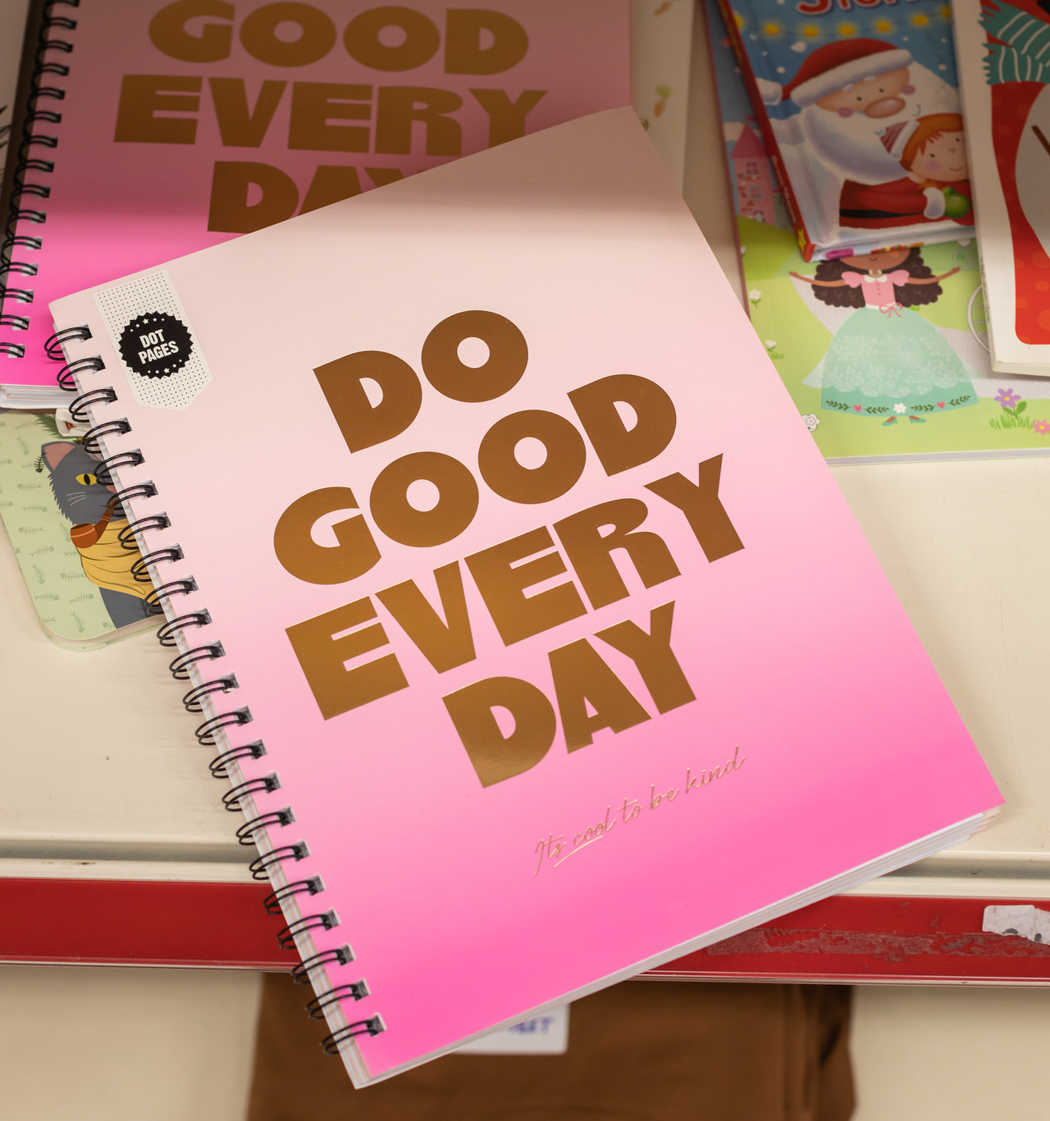
School Stationery
Each year we support families with new school stationary and replenish this throughout the year. With your support we can ensure every child is equipped to learn.
Be a ‘Back to School: Stationery Hero’ and donate:
From £500
Recognised on the night as proud supporters of the Smart Start Project
Recognised on our website as proud supporters of Wood Street Mission
Impact information for CSR reporting

Slide 10
Thank-You
To support please contact:
fundraise@woodstreetmission.org.uk

